Slide 1


Slide 2
Database Management Systems
Week 1, Day 3
MySQL—A RDBMS
Atta Muhammad
+92-333-1971110
attapanhyar@quest.edu.pk

Slide 3

Introduction
SQL is the standard language for dealing with Relational Databases.
SQL is used to insert, search, update, and delete database records.

Slide 4
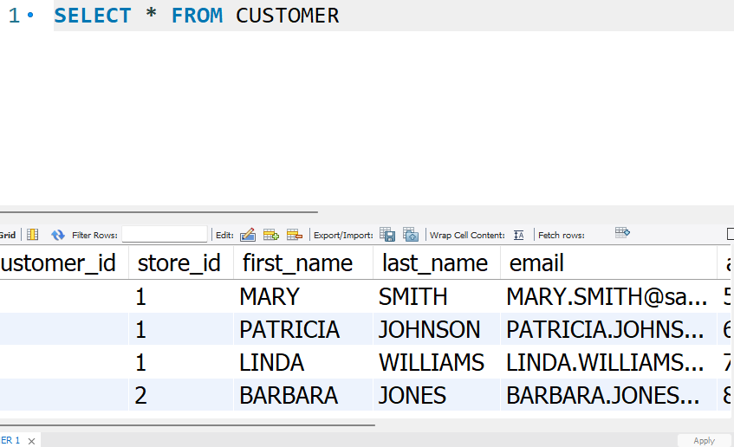
Your first Query 🤗
The following SQL statement selects all the records in the "Customers" table:

Slide 5
Keep in Mind That 🤷‍♀️
SQL keywords are NOT case sensitive: select is the same as SELECT

Slide 6

The MySQL SELECT Statement
The SELECT statement is used to select data from a database.
The data returned is stored in a result table, called the result-set.

Slide 7
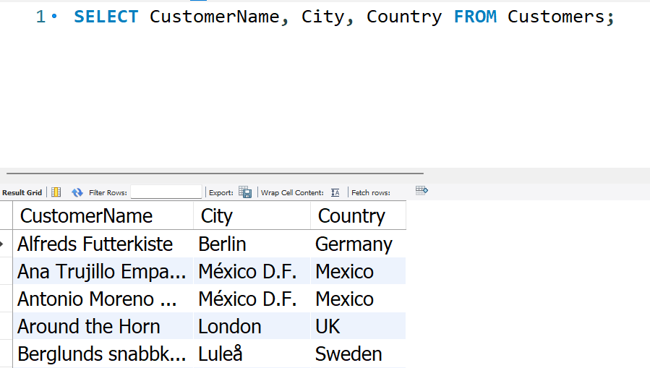
SLELECT EXAMPLE

Slide 8
SELECT DISTINCT Statement
The SELECT DISTINCT statement is used to return only distinct (different) values.

Slide 9
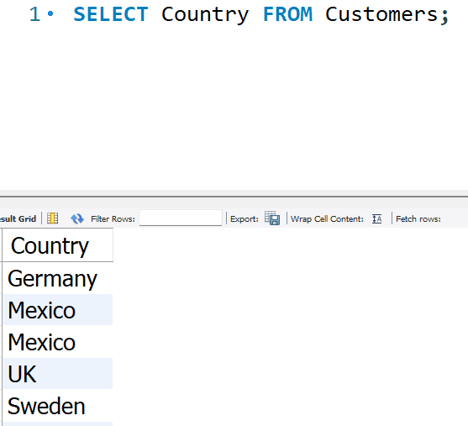
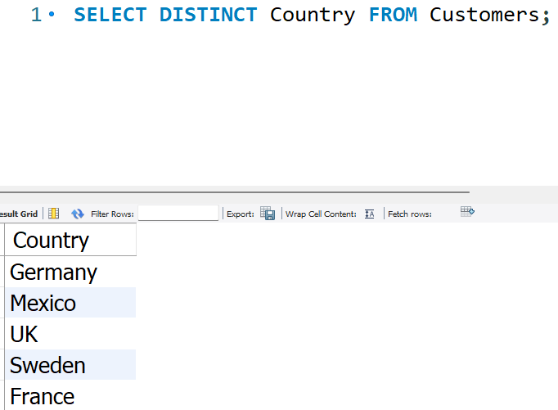
SELECT DISTINCT Statment

Slide 10
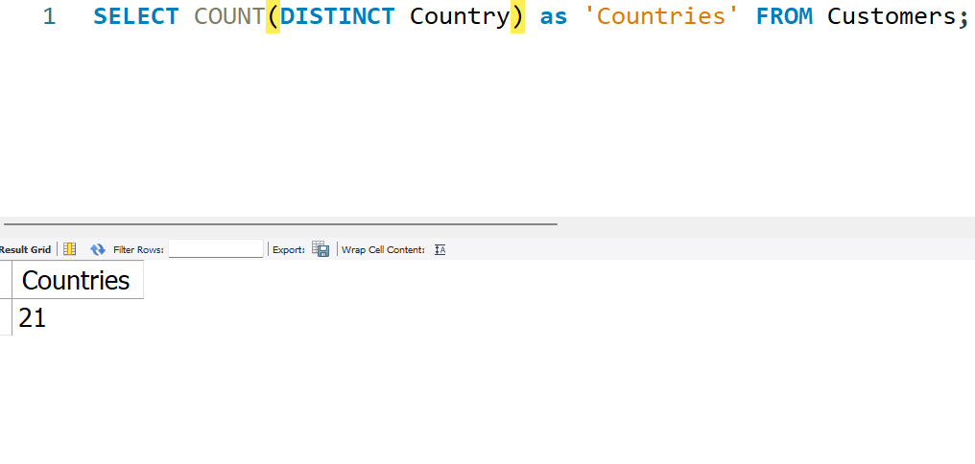
How many countries have our customers?

Slide 11
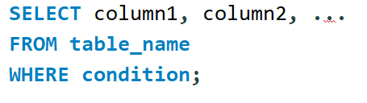
WHERE Clause
The WHERE clause is used to filter records.
It is used to extract only those records that fulfil a specified condition.

Slide 12
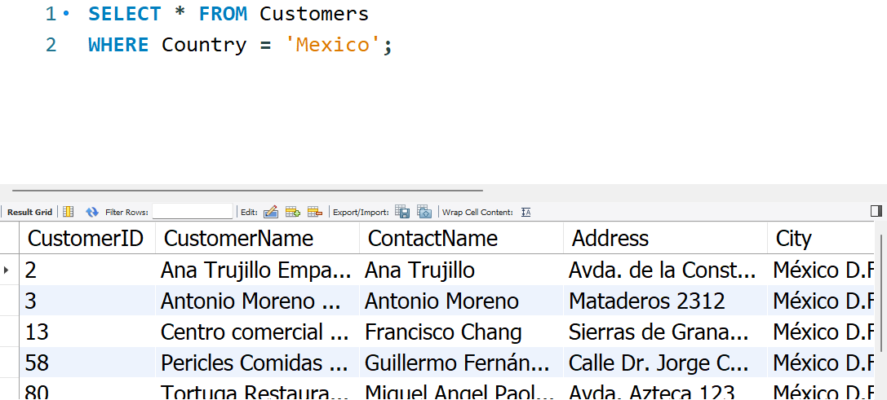
WHERE CLAUSE

Slide 13
Operators in The WHERE Clause
EQUAL (=)
GREATER (>)
LESS (<)
NOT EQUAL TO (<>)
BETWEEN ( RANGE)
LIKE (Search pattern)
IN ( TO SPECIFY multiple values)

Slide 14
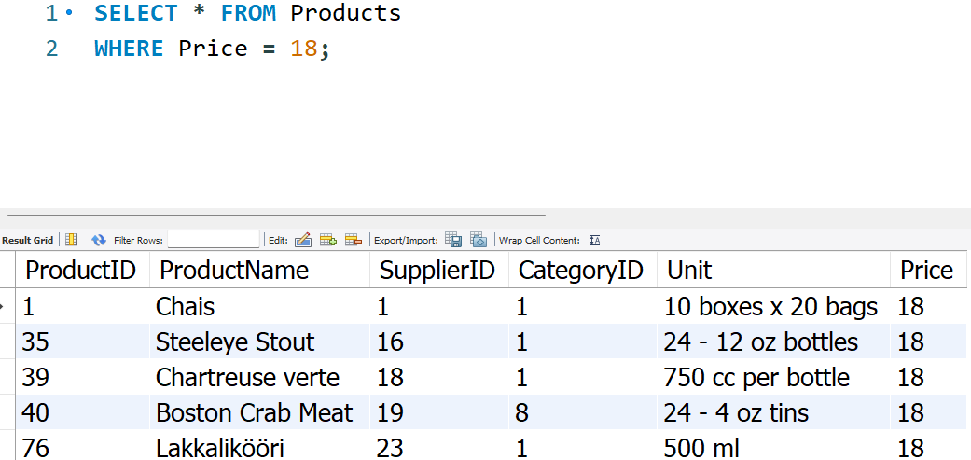
EQUAL

Slide 15
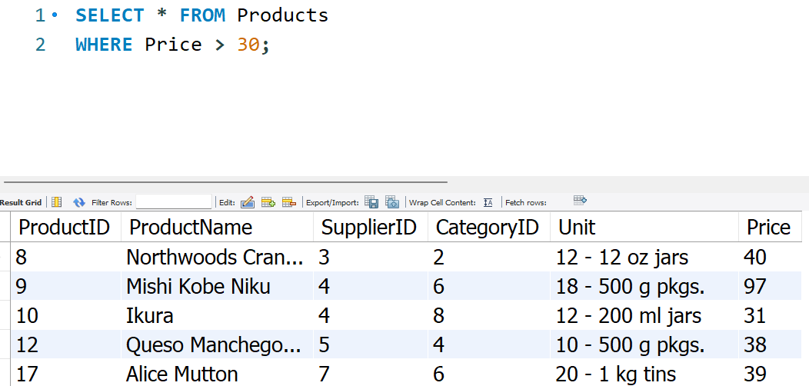
GREATER THAN (>)

Slide 16
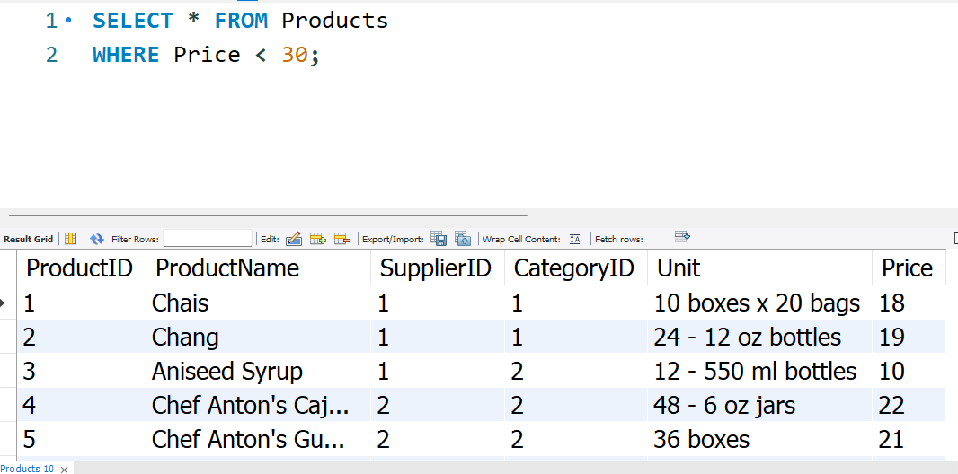
LESS THAN (<)

Slide 17
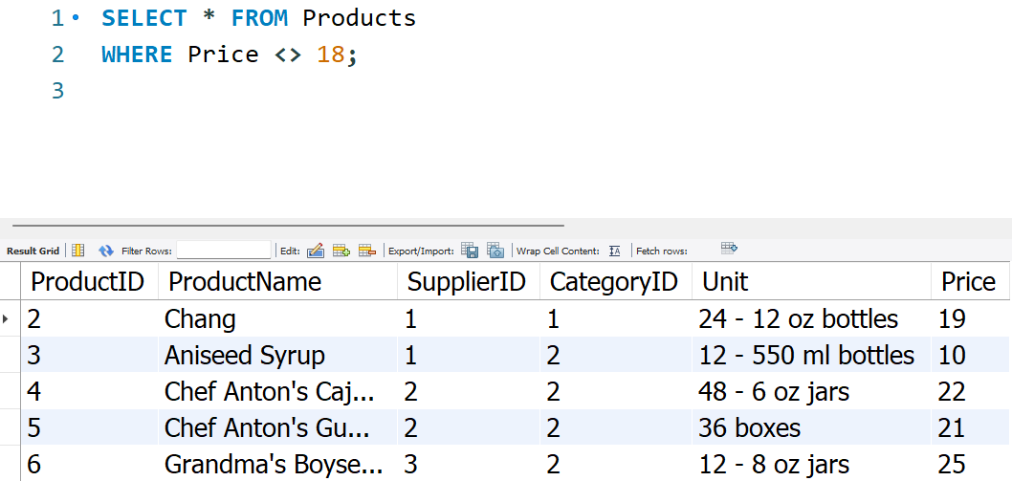
NOT EQUAL TO (<>)

Slide 18
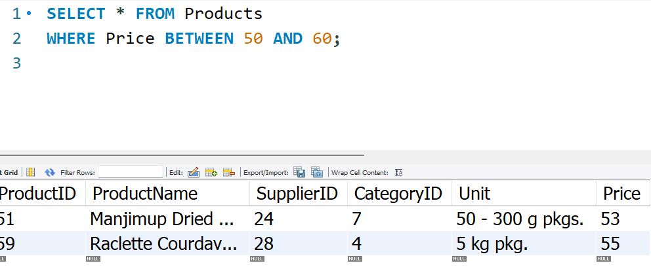
BETWEEN

Slide 19
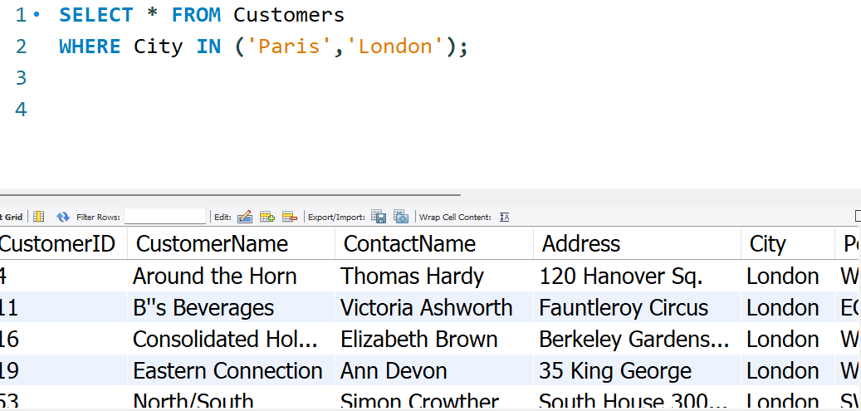
IN

Slide 20
AND, OR and NOT Operators
The WHERE clause can be combined with AND, OR, and NOT operators.
The AND and OR operators are used to filter records based on more than one condition:
The AND operator displays a record if all the conditions separated by AND are TRUE.
The OR operator displays a record if any of the conditions separated by OR is TRUE.
The NOT operator displays a record if the condition(s) is NOT TRUE.

Slide 21
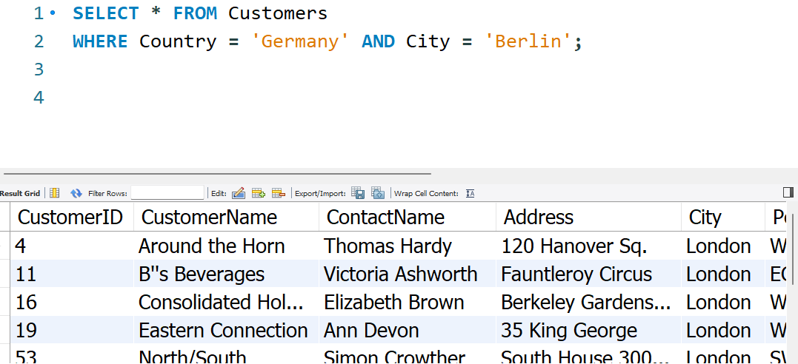
AND

Slide 22
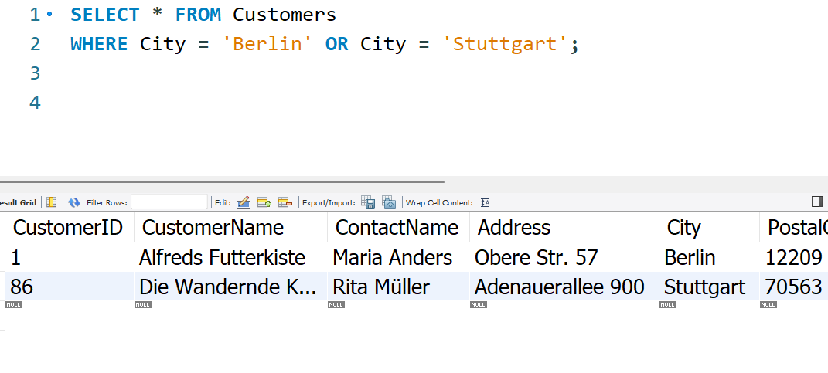
OR

Slide 23
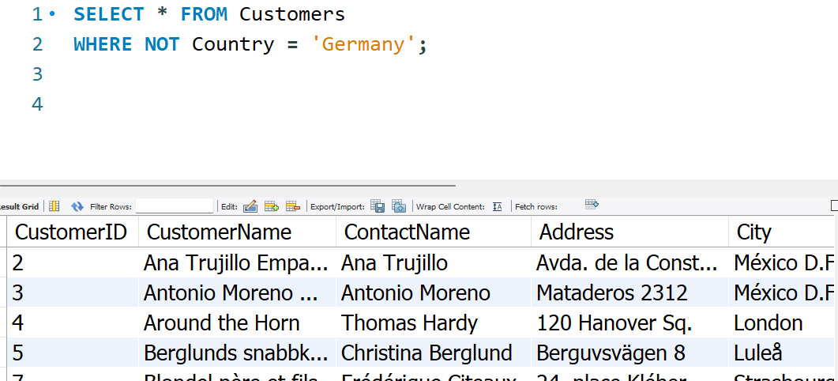
NOT

Slide 24
Question

